Slide 1
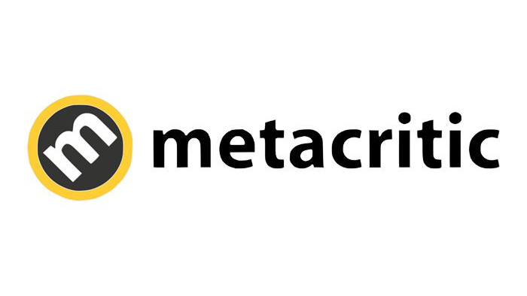
Metacritic Critic Review Analysis
Hanxiao(Mia) Zhang

Slide 2



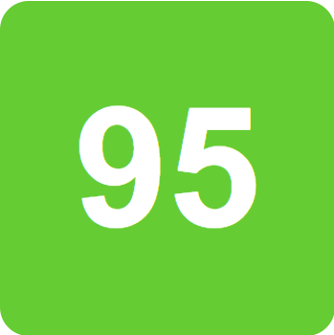
JOKER
Todd Phillips' controversial Joker origin story won Venice. Is an Oscar nomination next?
PARASITE
Bong Joon-ho's savagely funny Cannes winner could be 2019's best film.

Slide 3
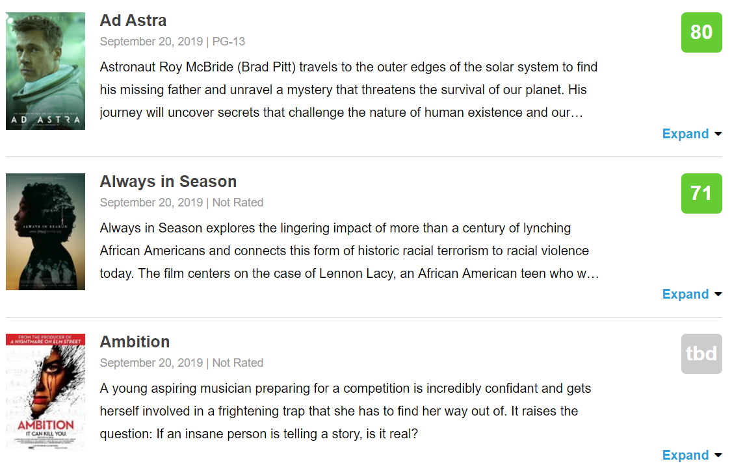
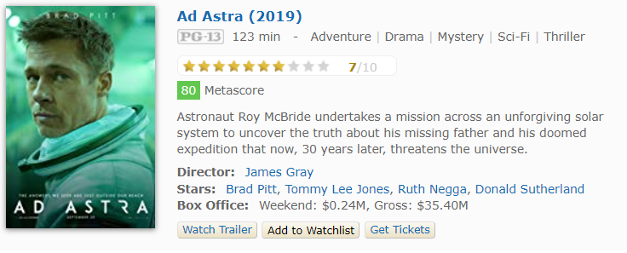
Metacritic
About Metacritic
Launched in January 2001, Metacritic has evolved over the last decade to reflect their experience distilling many critics' voices into the single Metascore, a weighted average of the most respected critics writing reviews online and in print.
IMDb

Slide 4
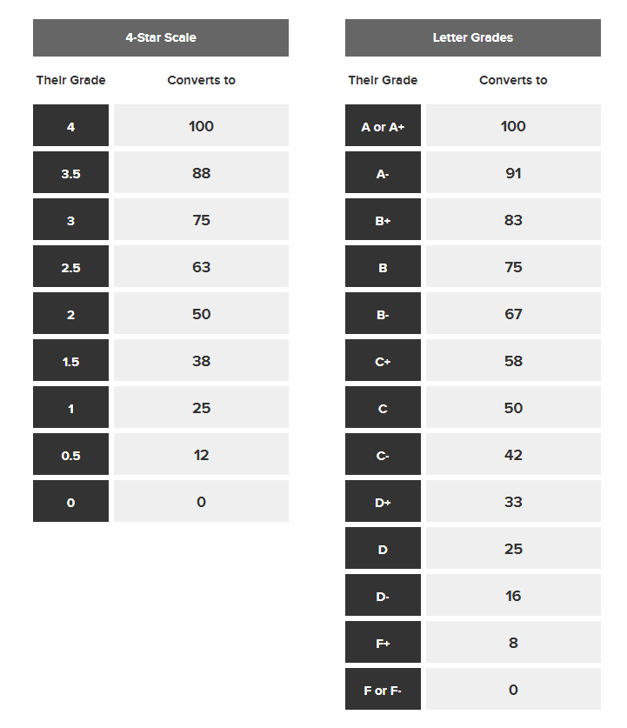
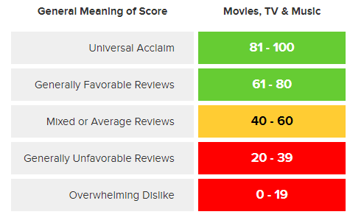
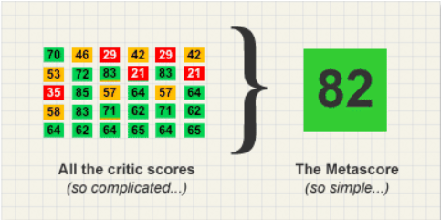
How To Create A Metascore

Slide 5
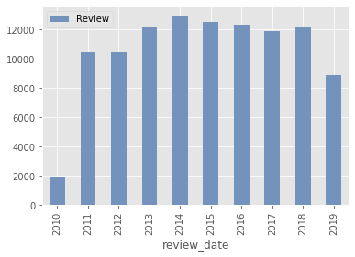
Metacritic Annual Reviews
Data Summary
12,635 Movies
25 Genres, 1,244 Distributors
247,009 Reviews & Scores
Once Upon a Time in Hollywood – 61 Reviews
273 Media Companies
Multiple reviews from the same media is possible
3,069 Critics
Roger Ebert from Chicago Sun-Times wrote 4,753 reviews

Slide 6
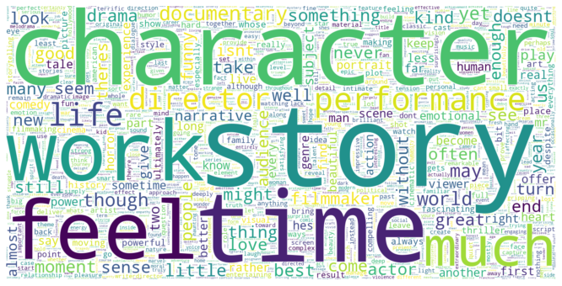
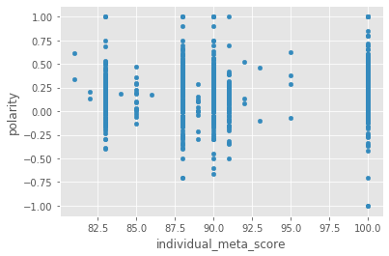
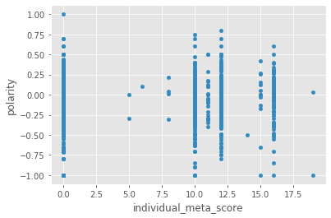
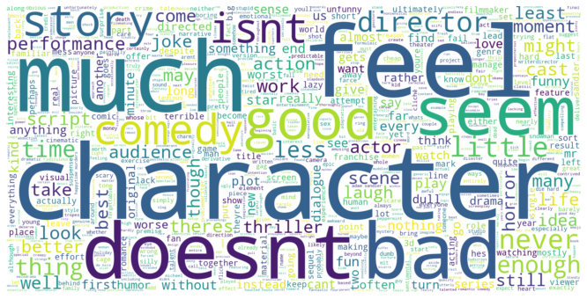
>80
<20

Slide 7
>80

Slide 8
<20

Slide 9
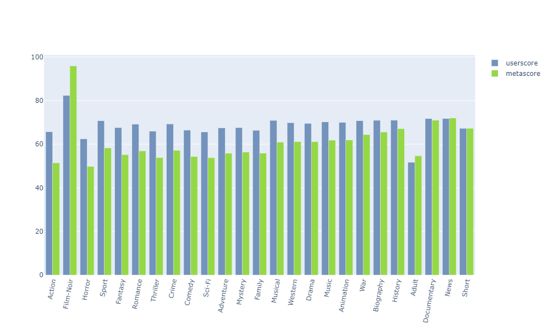
Critic & User Genre Preference

Slide 10
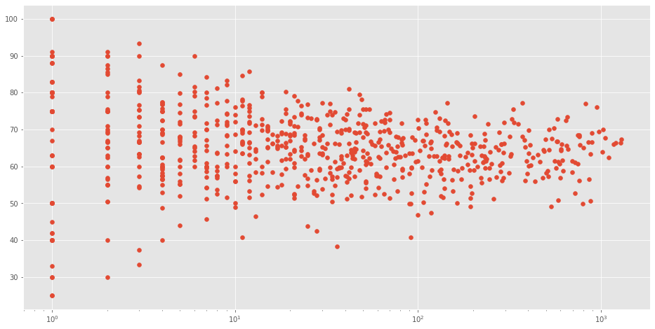
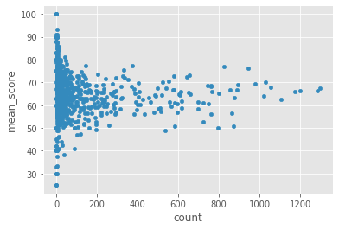
Critic Review Average Vs Review Quantity

Slide 11
Review Date Analysis

Slide 12
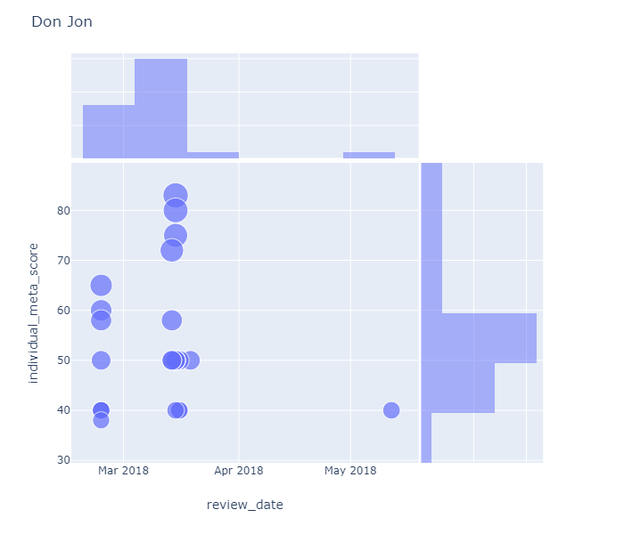
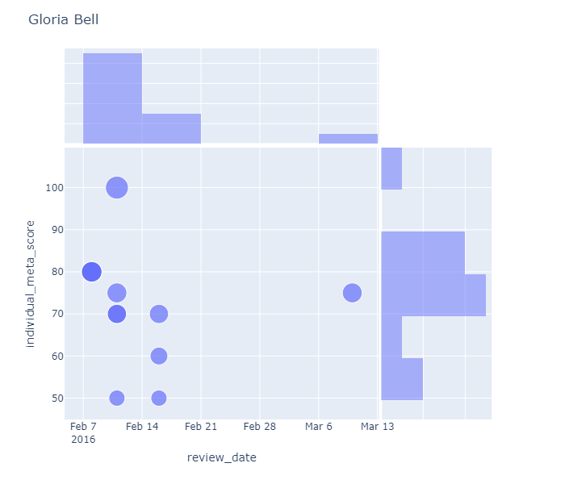
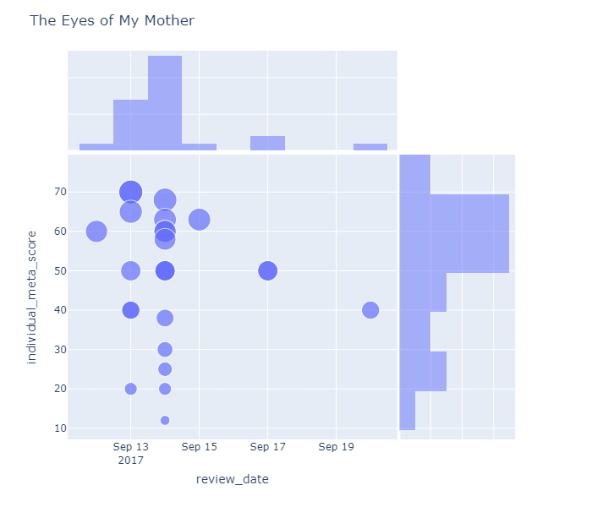
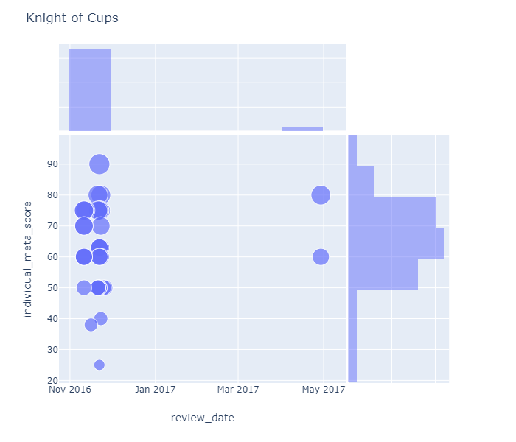
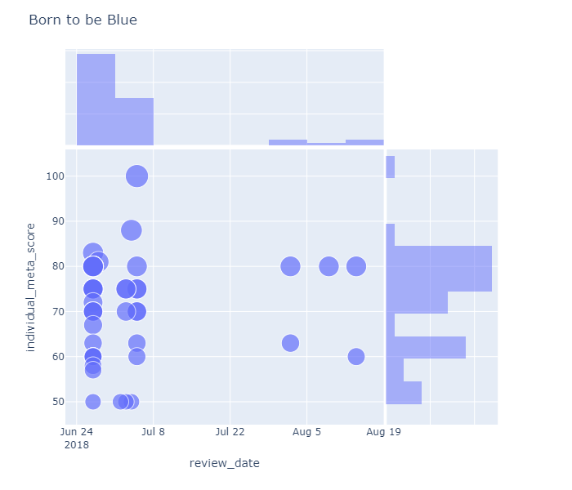
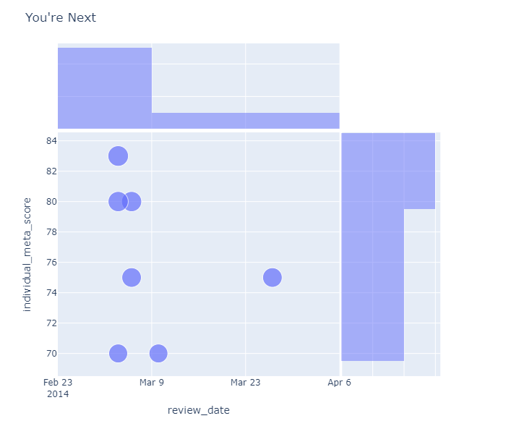

Slide 13
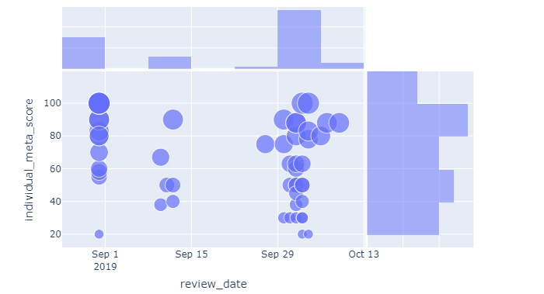
Joker Review Date Analysis
Venice Movie Festival
Movie Release
Metascore 59
Critic Screening
The New Yorker 30
The New Yorker 20

Slide 14
Make Your Own Decision
Genre Preferences
Review Date
Critics prefer documentary, drama, history to horror, action movies
Scores are higher before movie release date
Review Amount
Metacritic’s Choice
Critics with less reviews tend to have higher average scores or positive reviews
Private rating system to:
Choose respected critics
Assign scores to reviews
Apply weighted average

Slide 15
THANK YOU
Q & A

